Slide 1
STUDENT MANAGEMENT SYSTEM
By: Rameen Rafiq, Hafsa Salman, Laiba Fatima and Bharti

Slide 2
INTRODUCTION
PURPOSE
AUDIENCE
Provide students a platform where they can keep a track of their academic activities.
Administration staff
Students
Teachers
Development team
SCOPE
REFERENCE
Basic features of “Student Management System”
Show warning signs to keep track.
javatpoint
geeksforgeeks

Slide 3
FUNCTIONALITIES
Login and logout
Authentication
Attendance
Marks
Individual GPA
Cumulative GPA
Fee Structure

Slide 4
USER CLASSES AND OPERATING ENVIRONMENT
USER
CLASSES
OPERATING ENVIRONMENT
Have knowledge of computers
Proficient in English
Should correctly enter the information.
Operating system: Windows
Language: JAVA
Software: JDK/JRE and IntelliJ IDE

Slide 5
CONSTRAINTS AND ASSUMPTIONS
CONSTRAINTS
ASSUMPTIONS
IDs and passwords: created by administrative staff.
Data will be fed by the end of the semester.
No new data will be entered or there will be no changes made.
Code on JAVA
Necessary to have JDK or JRE
Operating System: Windows

Slide 6
EXTERNAL INTERFACE REQUIREMENTS
USER INTERFACE
SOFTWARE INTERFACE
Easy to use interface
Suitable error messages for invalid ID/Password
Exception Handling for wrong inputs by the user
Windows OS
JDK/JRE
suitable IDE for JAVA
HARDWARE INTERFACE
COMMUNICATION INTERFACE
Monitor: Display program
Mouse: To point
Keyboard: To input information
TCP/IP connections
Easy navigation
Multi-user handling

Slide 7
System
Features

Slide 8
Authentication
The authentication is the first and foremost feature of the Student Management System, with the highest priority, without which the program will not move further.
This feature will ask for student ID and password, and check against the credentials already stored in the system for verification purposes.
Functional Requirements:
User shall be able to login through their credentials
The system should authenticate login credentials against the data saved
The user is presented with a number of options for the authenticated student ID to choose from

Slide 9
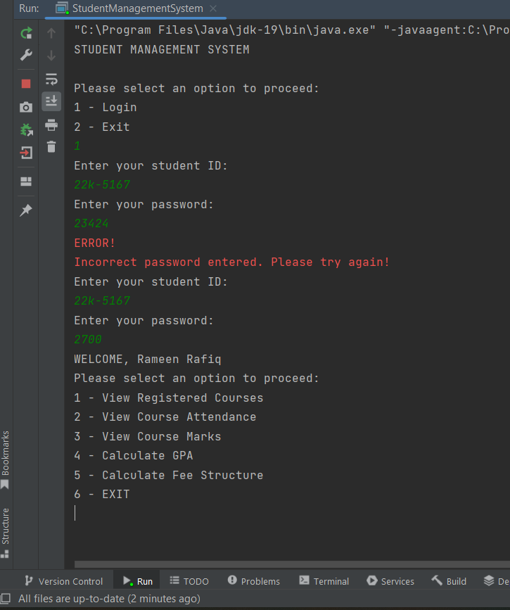

Slide 10
2) View Registered Courses
For any given student, this feature provides the list of all the registered courses for the current semester.
The student ID and name are displayed firstly, followed by columns of course code and names.
Functional Requirements:
For any student ID, the registered courses code and names are displayed
This feature does not require any input from the user.

Slide 11
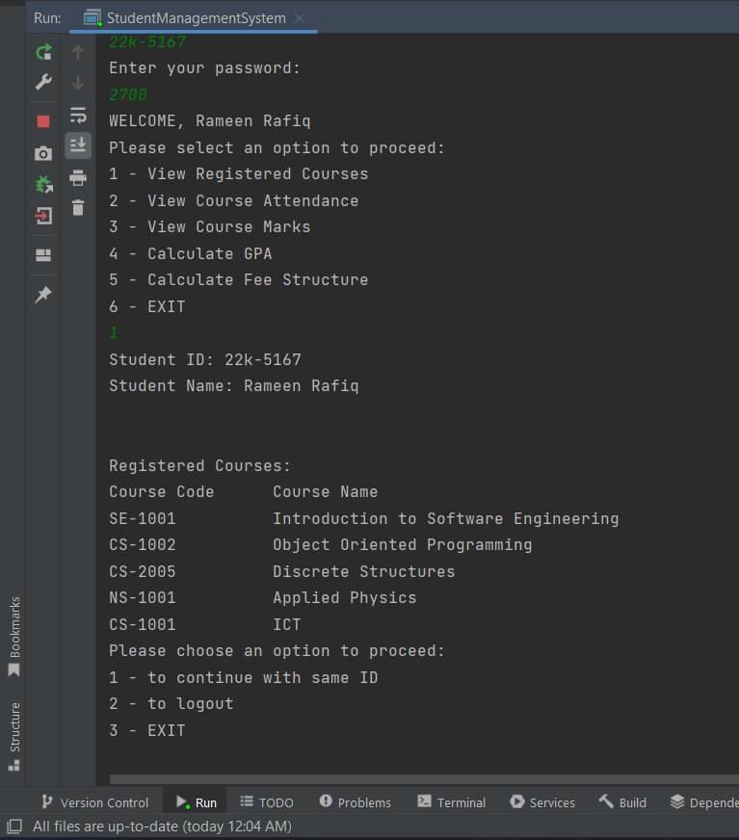

Slide 12
3) View Attendance
The function displays the registered courses and prompts the user to enter the course code for which they want to view attendance. Upon entering a valid code, the function displays the course name and attendance details including total number of classes, classes attended, and attendance percentage
Functional Requirements:
For any student ID, the registered courses code and names are displayed
The user will be allowed to choose from any course to view attendance for
Total classes will be displayed
The number of classes attended by the student are shown
Attendance percentage of classes percentage are calculated and displayed
Notes:
View Attendance

Slide 13
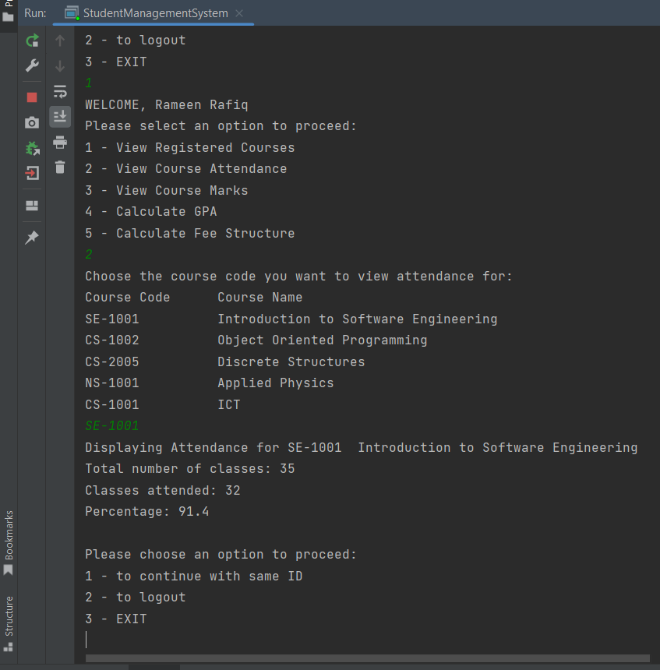

Slide 14
4) View Marks
The feature displays the list of registered courses and asks the user to enter the course code for which they want to view marks. Upon entering a valid code, the function displays the course name and mark details including total marks and the marks obtained by the student.
Functional Requirements:
For any student ID, the registered courses code and names are displayed
The user will be allowed to choose from any course to view marks for
Total number of marks will be displayed
Marks obtained by the student in their chosen course will be shown

Slide 15
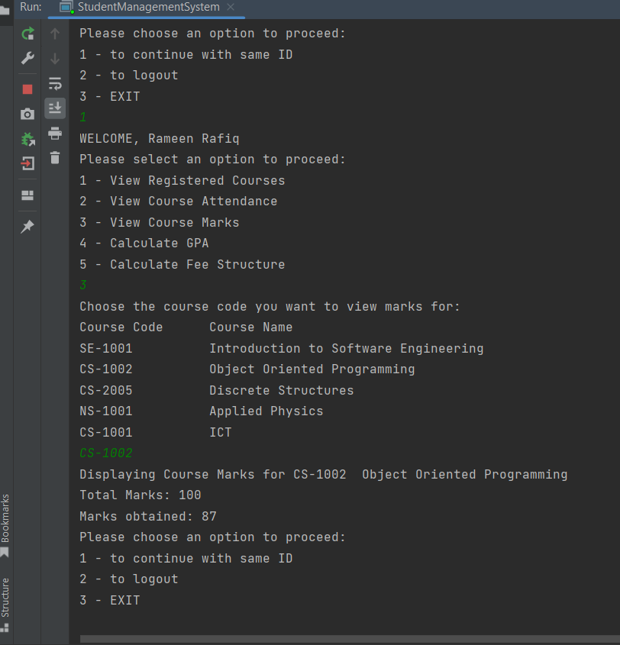

Slide 16
5) Calculate GPA
This feature allows for calculating individual course GPA or the cumulative GPA for all courses. For individual course GPA, the list of course codes and names will be displayed and the user will select a course. Upon entering a valid code, the function displays the course name, GPA, and grade. For cumulative GPA, the function displays all registered courses' names and codes followed by the cumulative GPA for the student.
Functional Requirements:
Calculation of any individual course GPA
The user will be asked to enter the course code to calculate GPA for
GPA for that individual course will be calculated and displayed
The corresponding grade will be displayed
Calculation of cumulative GPA of all registered courses
Overall GPA is calculated, and displayed

Slide 17
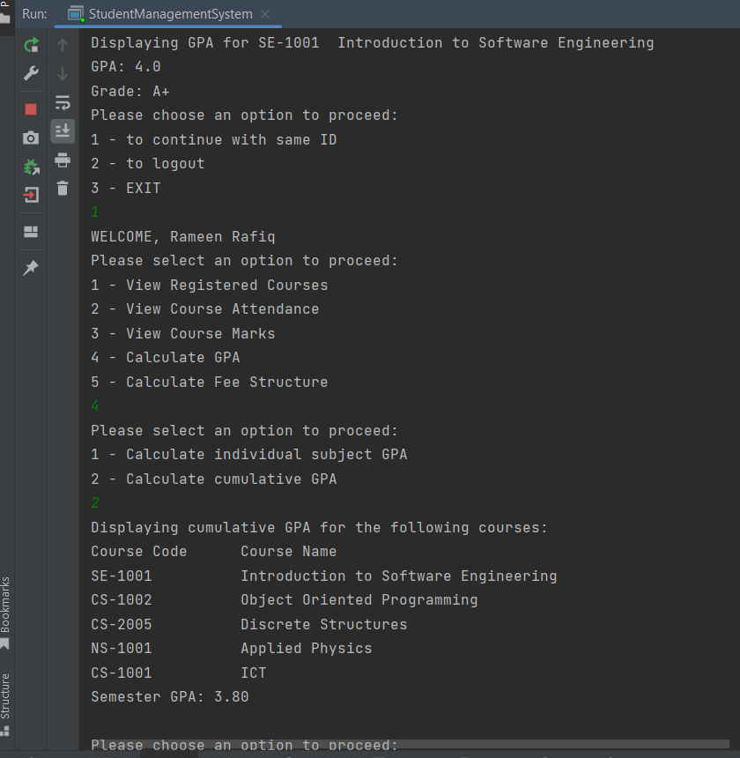

Slide 18
6) Calculate Fee Structure
The fee structure function displays the total semester fees for any particular student by adding the credit hours of all the registered courses and multiplying by a fixed per credit hour fees, which in this case is 8500.
It then displays the total credit hours for a particular student, the fee per credit hour, followed by the total fees for the semester.
Functional Requirements:
The user can view the semester fees for their registered courses
This feature does not require any input from the user.

Slide 19
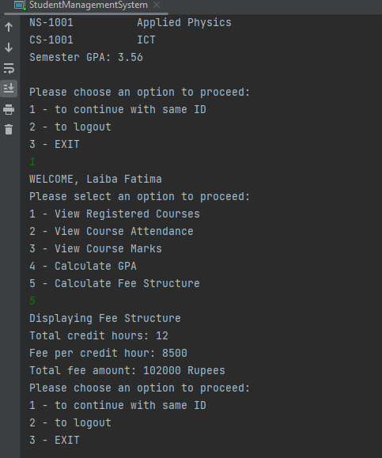

Slide 20
OTHER NON-FUNCTIONAL REQUIREMENTS
PERFORMANCE
SAFETY
Multiple user can access at the same time
No lagging
Fast Response Time
Smooth User Experience
Quick Prompts
No crashes on incorrect inputs
Does not collect personal data
No unauthorized access
Only access by correct id and passwords
Id and password provided by administrator

Slide 21
SOFTWARE QUALITY ATTRIBUTES
Adaptability: tendency to be modified over time
Availability: can be accessed at all times
Maintainability: modifications can be made easily.
Portability: can run on different devices/systems.
Reliability: functions are available when needed.
Reusability: separation of features into various functions makes it easier to reuse
Testability: code is easy to test and identify errors from
Usability: easy to use

Slide 22
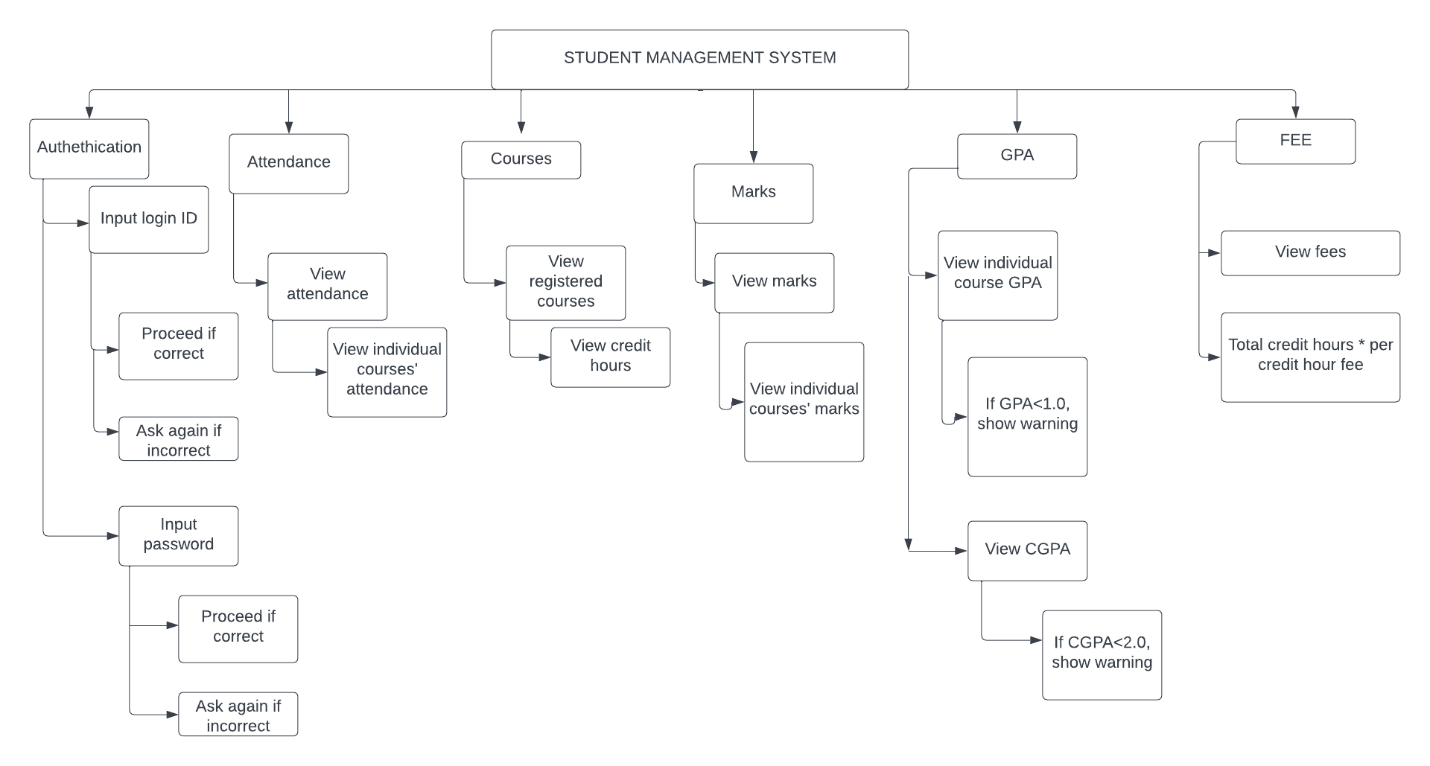
WBS

Slide 23
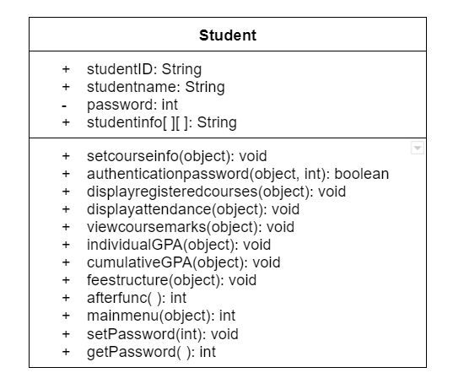
CLASS DIAGRAM

Slide 24
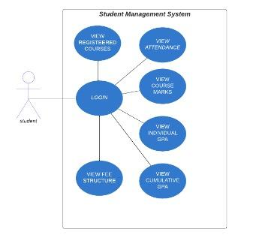
USE CASE DIAGRAM

Slide 25
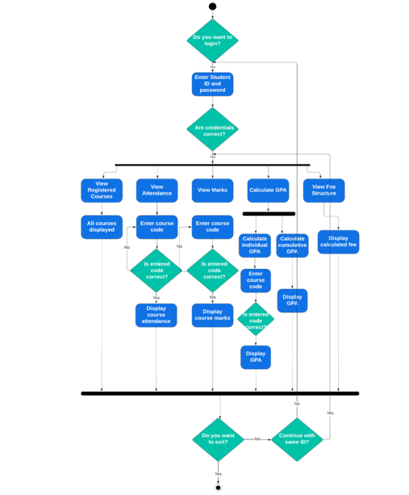
ACTIVITY DIAGRAM

Slide 26
THANK YOU!

